Slide 1
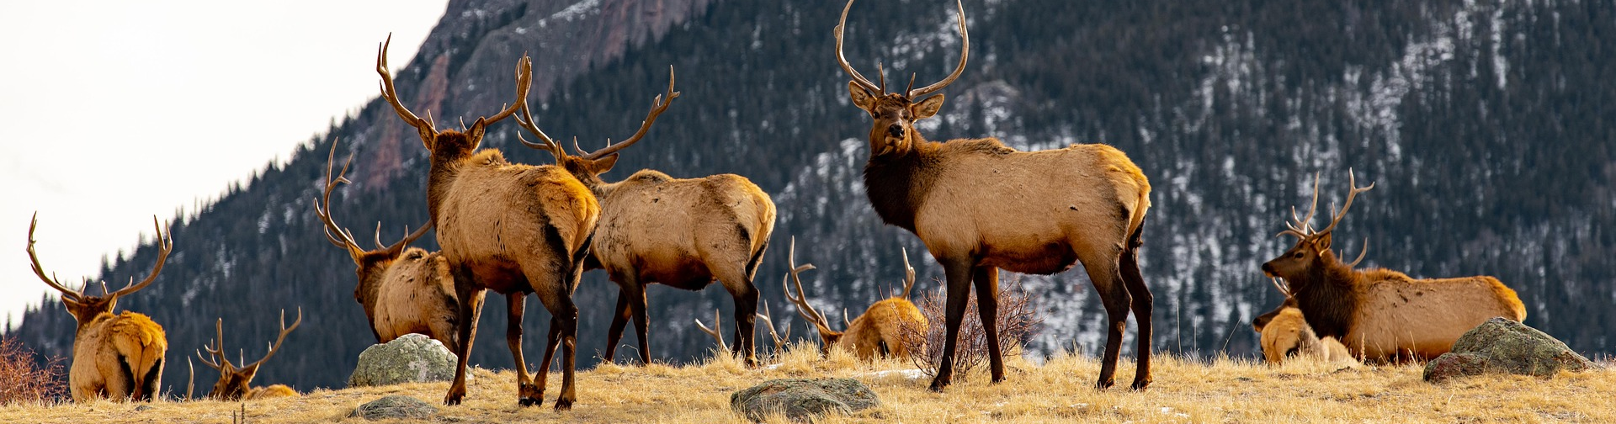
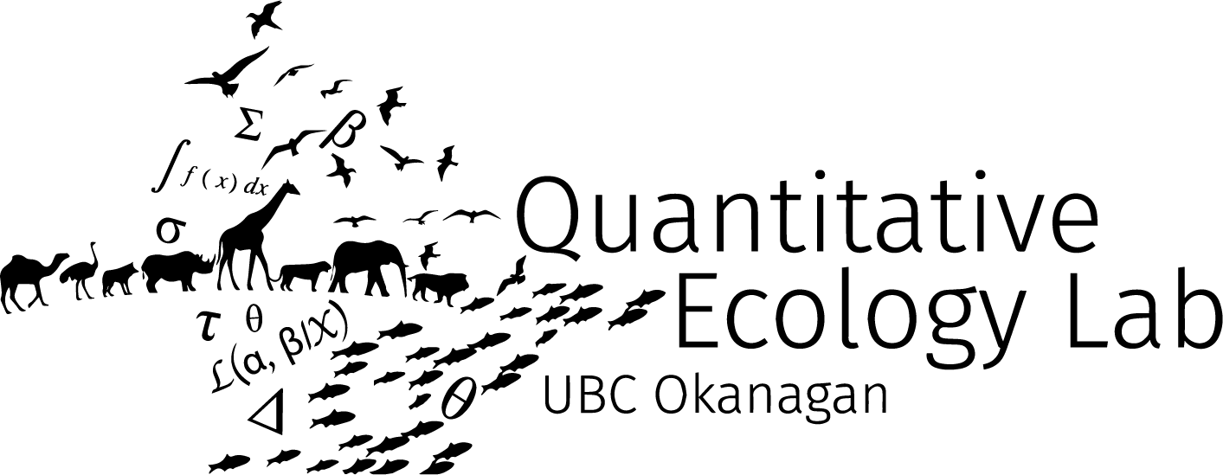

Global Trends in Mammalian Reproductive Health: A Cross-Species Study of Sperm Abnormalities over Time
Nozomu Hirama
BSc Honours Zoology
Supervisor: Michael J. Noonan

Slide 2

Reproduction is essential for population growth
Survival

Slide 3
Reproduction is essential for population growth
Survival
Reproduction

Slide 4
Reproduction is essential for population growth
Survival
Reproduction
Growth

Slide 5
Reproduction is essential for population growth
Survival
Reproduction
Growth

Slide 6
Reproduction is essential for population growth
Survival
Reproduction
Growth

Slide 7
Reproduction is essential for population growth
Survival
Reproduction
Growth

Slide 8
Reproduction is essential for population growth
Survival
Reproduction
Growth
Little focus on reproductive health!!

Slide 9
How do we measure reproductive health?
Fertility rates – May take long to obtain, small sample size
Estrus detection – Dependent on careful observations
Oocyte assessment – Invasive, small sample size
Sperm assessment – Easy and mostly non-invasive

Slide 10
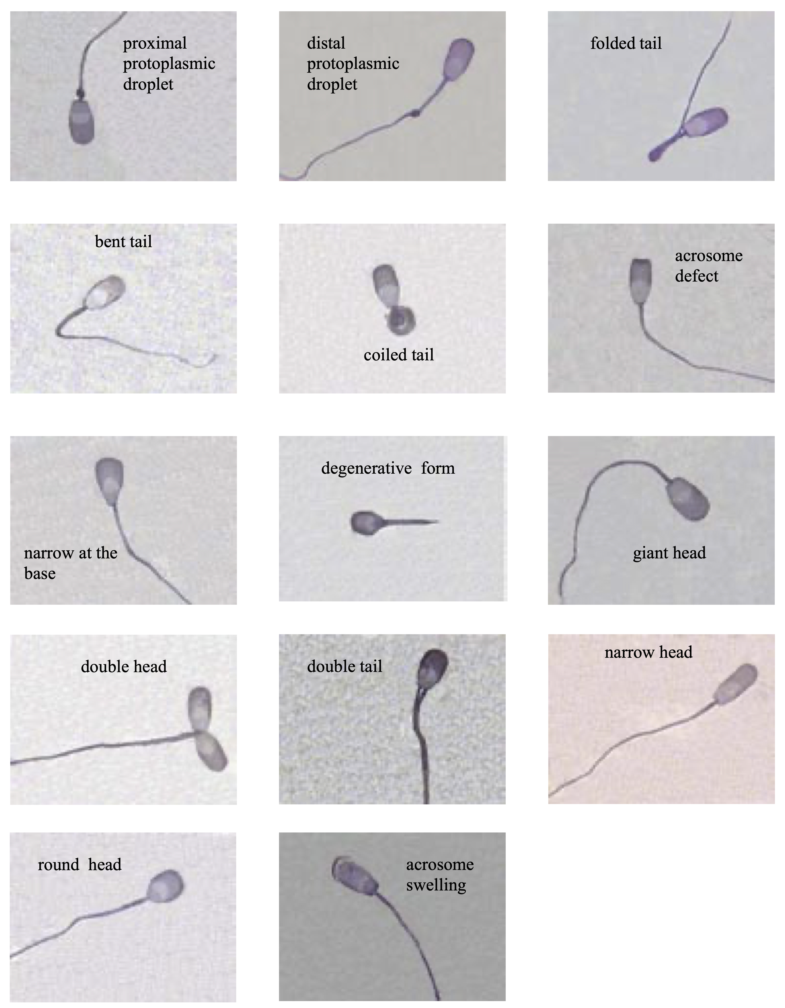
Sperm assessment
Morphology often used as an indicator of reproductive health
Abnormalities lead to lower rates of successful reproduction (Love, 2011)
Other measures include motility, concentration, viability…
(Čeřovský et al., 2005), CC BY-NC 4.0 DEED

Slide 11
Past Studies

Slide 12
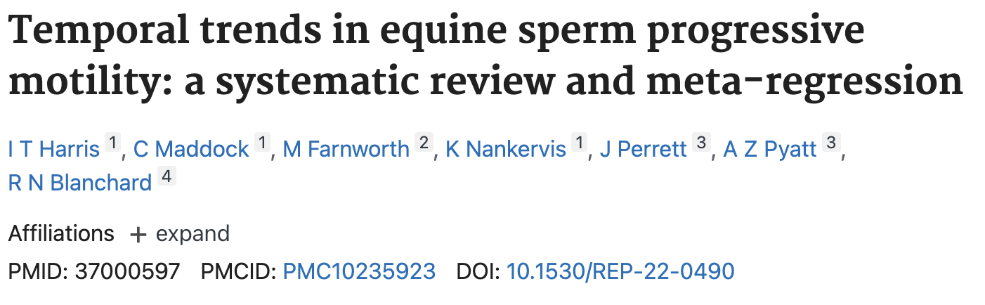
Past Studies
- Motility in horses

Slide 13
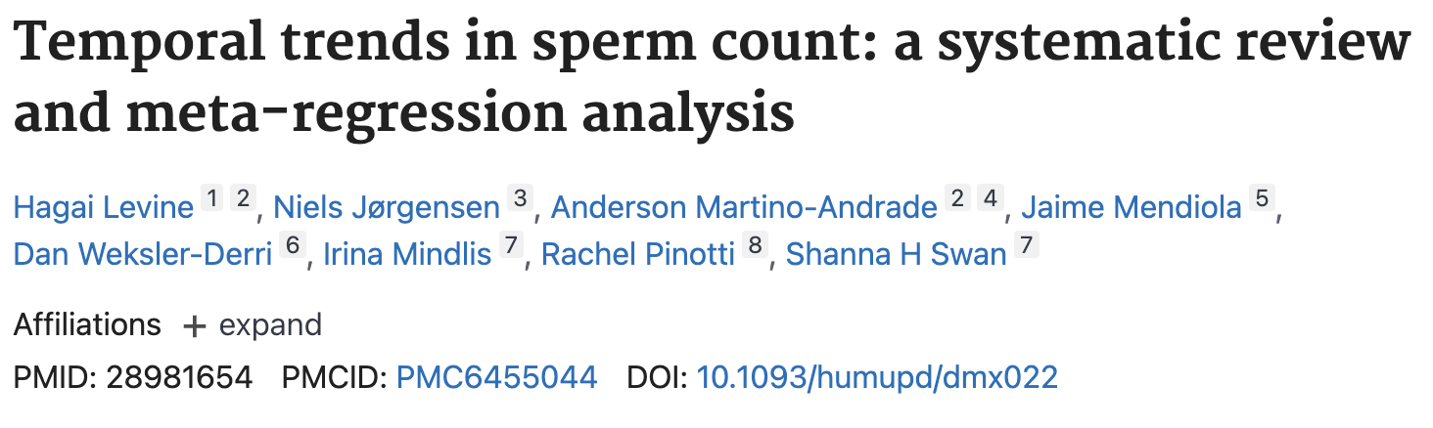
Past Studies
- Motility in horses
Sperm count in humans -

Slide 14
Past Studies
Not much…

Slide 15

Past Studies
Other taxa?
Overall trends?
biodiversity by Softscape from Noun Project (CC BY 3.0)

Slide 16
Objectives
Assess current state of research
Characterize global trends in mammalian reproductive health
Estimate and compare trends across different taxa

Slide 17
Literature review
Assessment
Started with set of easily-found sperm quality articles
Web of Science search of peer-reviewed articles with randomized list of all mammalian species
Search term:
“scientific name” OR “common name” OR “alternative names”
AND Sperm* OR Semen* OR Reproduct* OR Semin* OR Ejaculat*
AND Normal OR Abnormal OR Motil*

Slide 18
Literature review
Assessment
Collected six spermatic trait measurements
% Morphologically normal sperm
% Head, Mid-piece, and Tail abnormalities
% Motile sperm
% Intact acrosome
And other potentially relevant information

Slide 19
Literature review results
Assessment
277 mammalian species described in papers ranging from 1977 – 2024
Maximum sample size n=119 from 63 unique species for % normal sperm
Inconsistency in sperm collection methods, storing methods, and data availability throughout papers

Slide 20
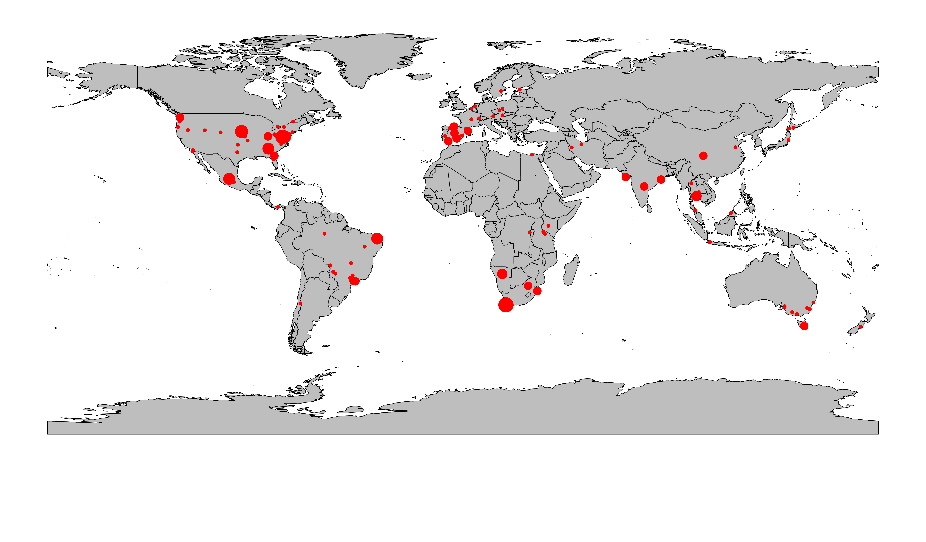
Global distribution of data
Assessment

Slide 21
Global temporal trends in spermatic traits
Global Trends
Phylogenetically-controlled beta GLMs were fit to each of the six traits
Publish date was used as an estimate of collection date
Diagnostic plots used to assess model adequacy

Slide 22
Global temporal trends in spermatic traits
Global Trends

Slide 23
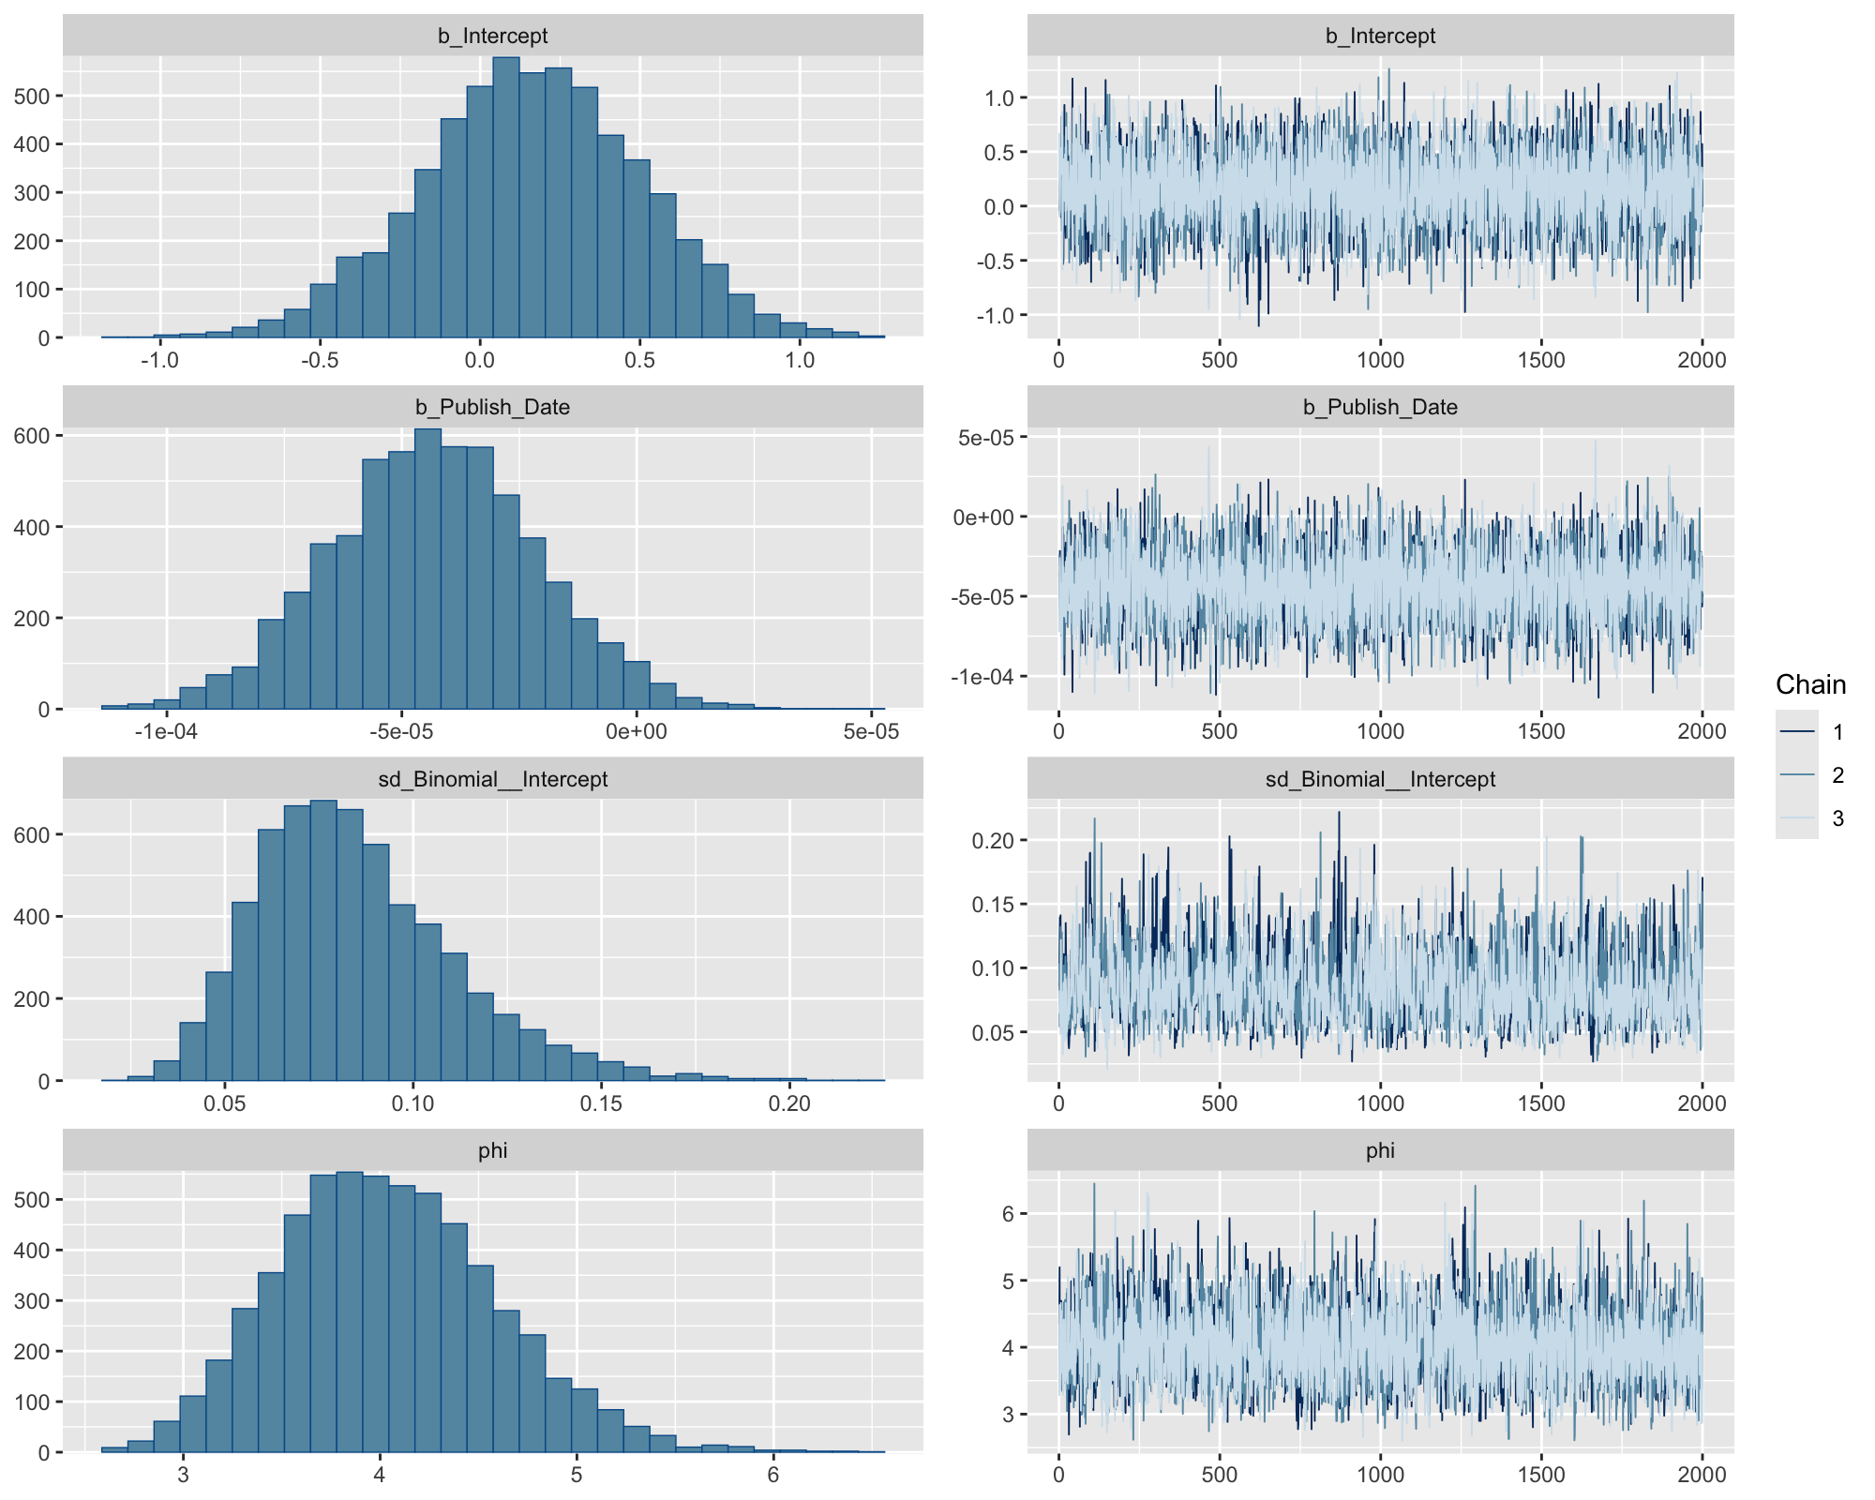
Diagnostic plots
Global Trends
Model fit to normal sperm proportion indicated sensible behavior
Similar behavior was observed for all other models

Slide 24
Taxonomic trends in normal sperm proportions
Taxonomic Trends
Species-level random effects were computed
Slopes were estimated as annual change in proportion of normal sperm
Effect sizes were visualized on a phylogenetic tree to identify any taxonomic trends
Identification of taxonomic differences can aid in shaping the scopes of future conservation plans.

Slide 25




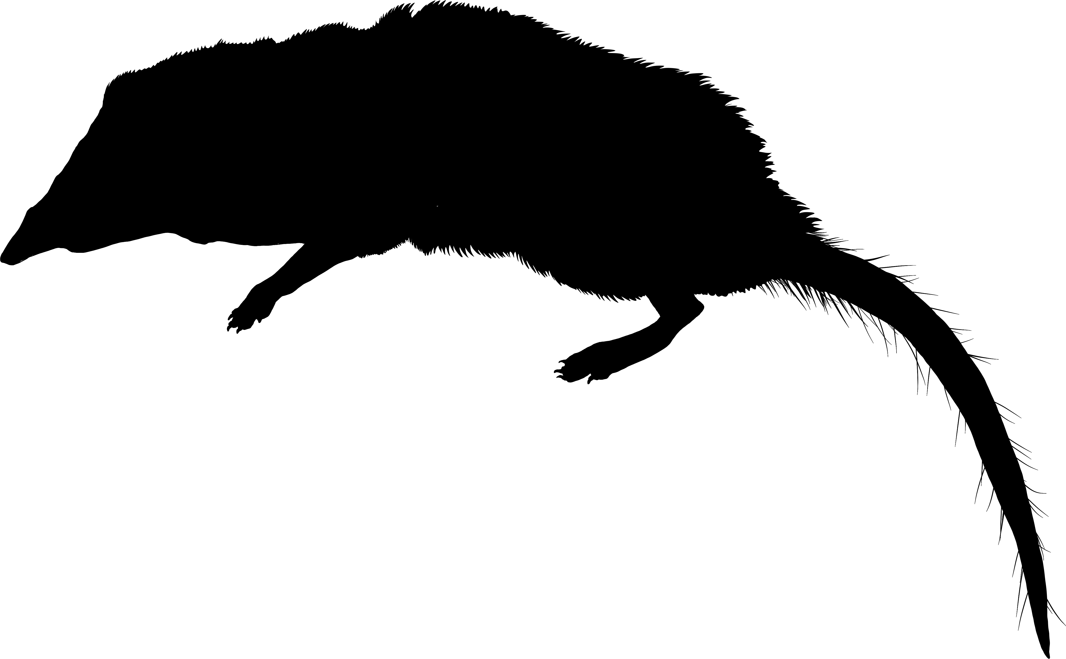





Taxonomic trends in normal sperm proportions
Taxonomic Trends
Variation among taxa
No clear structure
Both positive and negative slopes
Six-banded armadillo and arctic fox experienced notable increases

Slide 26
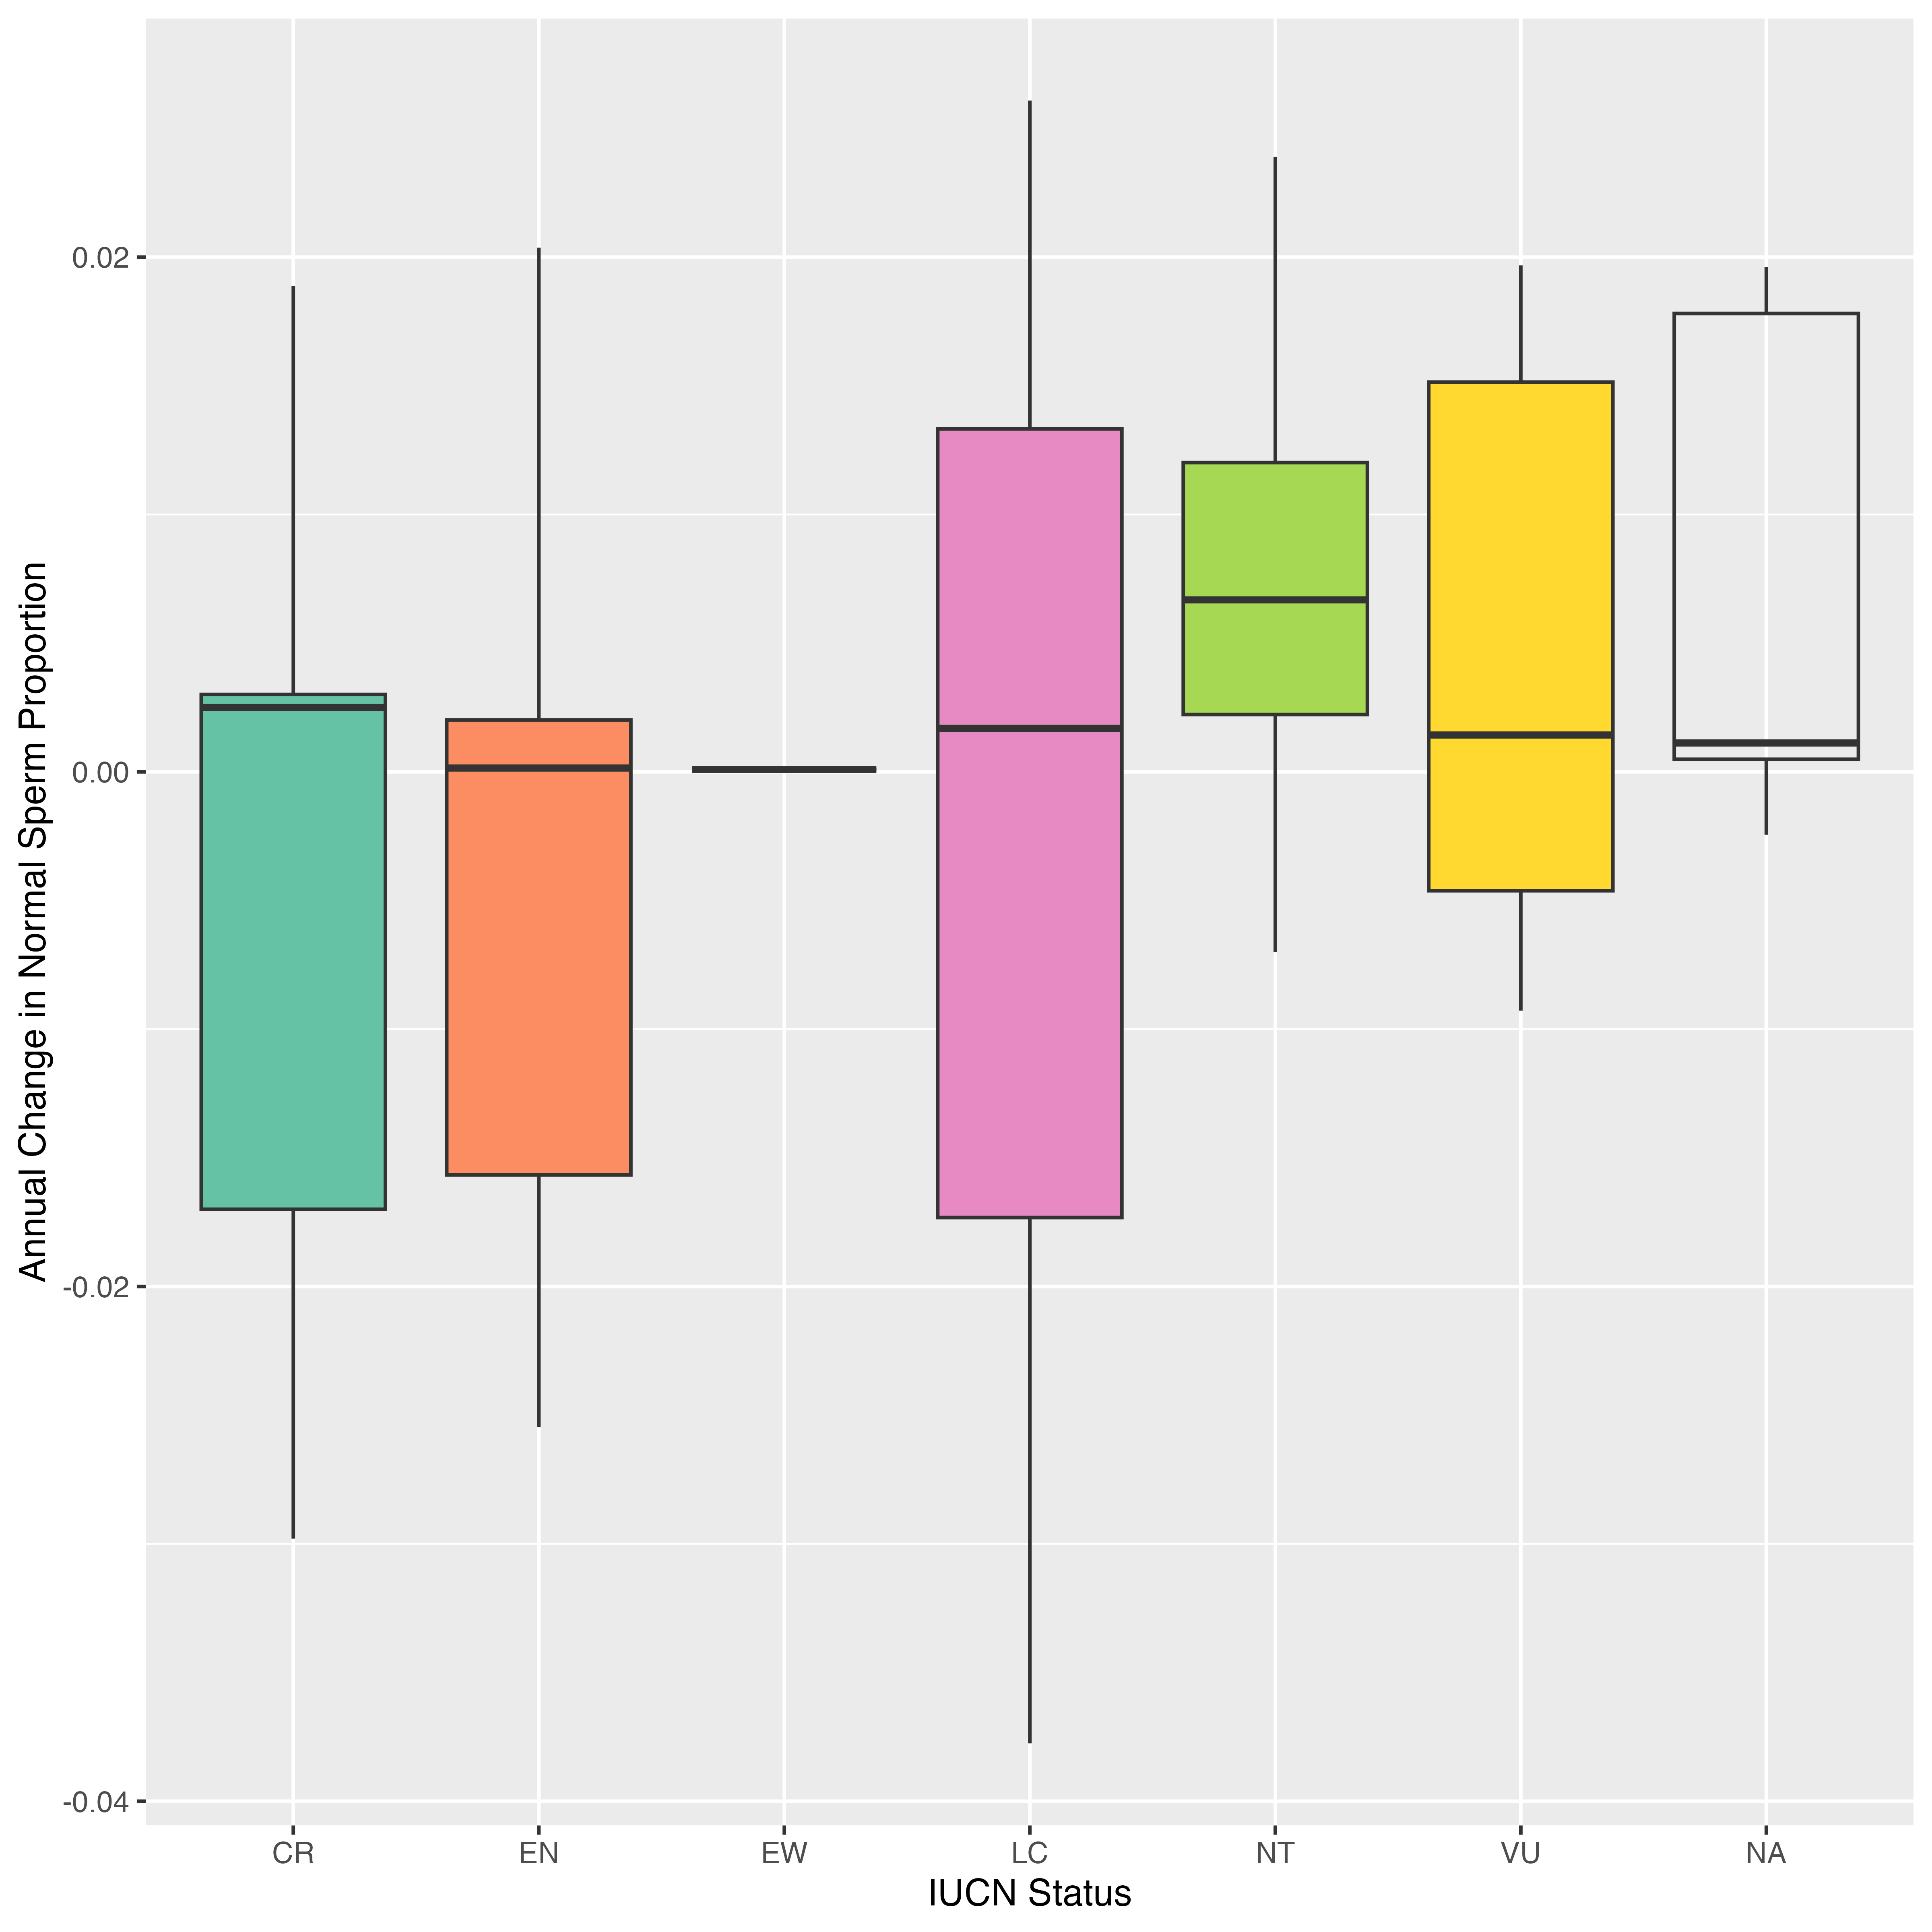
IUCN status and sperm quality trends
Taxonomic Trends

Slide 27
Future work
Expand dataset
Data readily available and can be easily added on to
Include more species, as well as more measurements per species
Link to biology
Identify potential mechanisms behind taxonomic differences
Apply to research/conservation
Reshape conservation approaches based on reproductive conditions given available information

Slide 28
References
Čeřovský, J., Frydrychová, S., Lustyková, A., & Rozkot, M. (2005). Changes in boar semen with a high and low level of morphologically abnormal spermatozoa. Czech Journal of Animal Science, 50(7), 289–299.
https://doi.org/10.17221/4170-CJAS
Harris, I. T., Maddock, C., Farnworth, M., Nankervis, K., Perrett, J., Pyatt, A. Z., & Blanchard, R. N. (2023). Temporal trends in equine sperm progressive motility: A systematic review and meta-regression. Reproduction, 165(6), M1–M10. https://doi.org/10.1530/REP-22-0490
Levine, H., Jørgensen, N., Martino-Andrade, A., Mendiola, J., Weksler-Derri, D., Mindlis, I., Pinotti, R., & Swan, S. H. (2017). Temporal trends in sperm count: A systematic review and meta-regression analysis. Human Reproduction Update, 23(6), 646–659. https://doi.org/10.1093/humupd/dmx022
Levine, H., Jørgensen, N., Martino-Andrade, A., Mendiola, J., Weksler-Derri, D., Mindlis, I., Pinotti, R., & Swan, S. H. (2017). Temporal trends in sperm count: A systematic review and meta-regression analysis. Human Reproduction Update, 23(6), 646–659. https://doi.org/10.1093/humupd/dmx022

